Slide 1
Class Amphibia (amphibians)
Amphibians belong to phylum Chordata
Class Amphibia comprises three orders:
Newts and salamanders – order Urodela have a long body with a tail and two pairs of limbs.
Frogs and toads - order Anura have a short body and long lower limbs.
Proteus - order Apoda have no limbs. Their fertilisation is internal.

Slide 2
Characteristics of amphibians
The body temperature of amphibians is unstable and this limits their distribution. They mostly occupy regions with warm and wet climate. They are distributed over all continents excluding Arctic and some ocean islands.
The body of amphibians consists of a head and trunk, which cannot be clearly distinguished. They live in two different environments, which influences both morphology and their physiology.

Slide 3
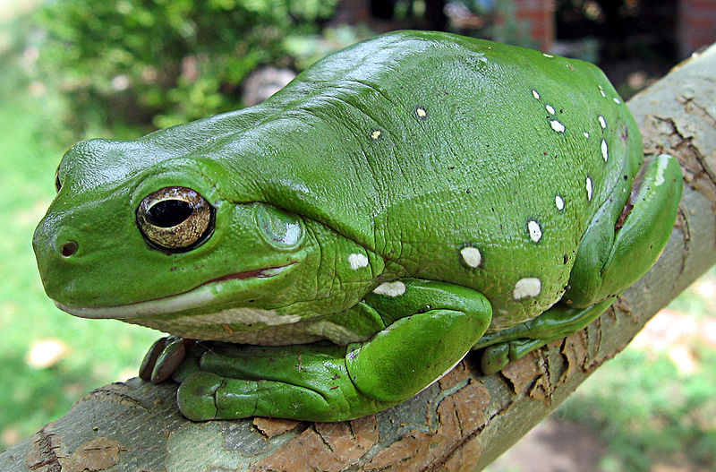
Distinguishing features
Amphibians are tetrapods vertebrates adapted to life both in water and on land.
Their skin is thin and rich in blood vessels. It has small glands that keep the skin moist and slippery. This eases gaseous exchange.
Two pairs limbs allow them to move in water and land.
Amphibians are poikilotherms.
Australian Green_Tree_Frog

Slide 4
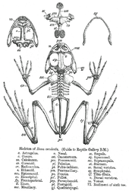
Amphibian skeleton consists of a skull, bones of the trunk and bones of the limbs. There is the breastbone which provides better support for the upper limbs.
Skull
front girdle
bones of the upper limbs
spinal column
bones of the lower limbs
hind (pelvic) girdle

Slide 5
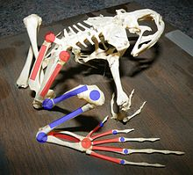
Two pairs of limbs allow them to move in water and land.
The skull and first vertebra atlas of the spinal column are connected by a mobile joint. Thus, amphibians can move their head up and down.
In water, amphibians are perfect swimmers and on land they jump.

Slide 6
Digestive system
Adult amphibians feed with insects, worms and spiders and their larvae are herbivorous. Most of them have long tongue and teeth, which they use to hold the prey. The digestive system ends with cloaca, which is the opening of the excretory and reproductive systems.

Slide 7
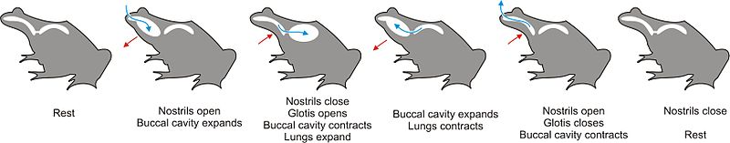
Amphibians respiration takes place through the skin, but also through the lungs. The lung has a primitive structure – it consists of two small balloons, like structures covered with a net of blood vessels.
They breathe through their skin and lungs.

Slide 8
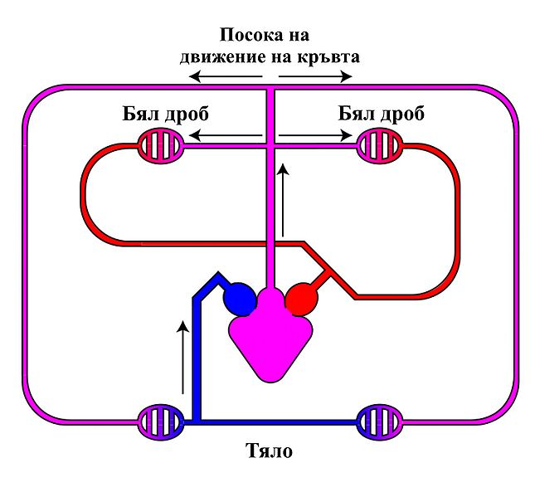
Their heart consists of three cavities – two atriums and one ventricle . In the ventricle venous and arterial blood are mixed and pumped into the tissue where it are gave the oxygen of the cells. This is the reason for the unstable body temperature of the amphibians.
They have pulmonary and systemic circulation.
pulmonary
pulmonary
Systemic circulation

Slide 9
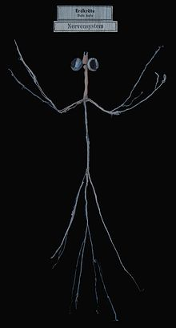

The brain of amphibians has a more complex structure, due to their living in two different environments. The brain is composed of two hemispheres.
Sensory organs are also well developed.
Eyelids
Middle ear with tympanic membrane

Slide 10
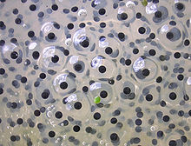
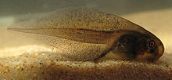
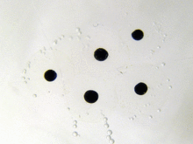
Their reproduction and development takes place in water. The eggs are rich nutrients, but they have a thin membrane and can survive only in water.
They develop through metamorphosis.
Larvae - tadpoles, just as fish, breathe through gills.
Frogs development
Frogs eggs
Larvae- tadpole

Slide 11
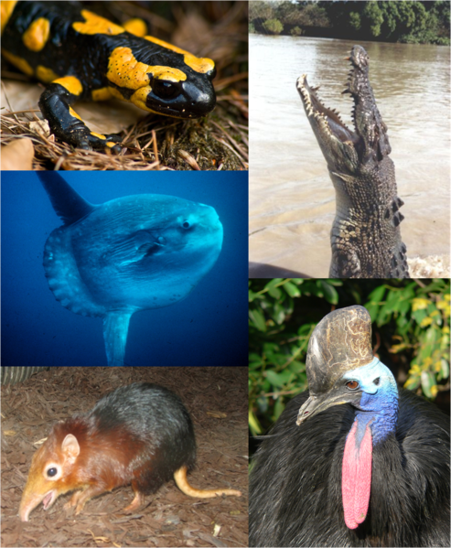
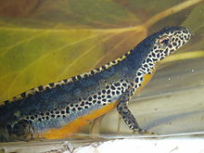
Class Amphibia include only 2,500 species divided into three orders: salamanders (Urodela);frogs (Anura) and Apoda (Legless Amphibians)
Order salamanders – comprises about
340 species with an elongated trunk,
ending in a long tail. They are
distributed mainly northern
hemisphere. Most salamanders are
small size –a few centimeters.
Many Salamanders are good
swimmers. They use their long tail to
swim and on land they walk. In most
species, fertilisation is internal.
Slender Salamander
Great crested
newt

Slide 12
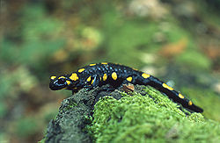
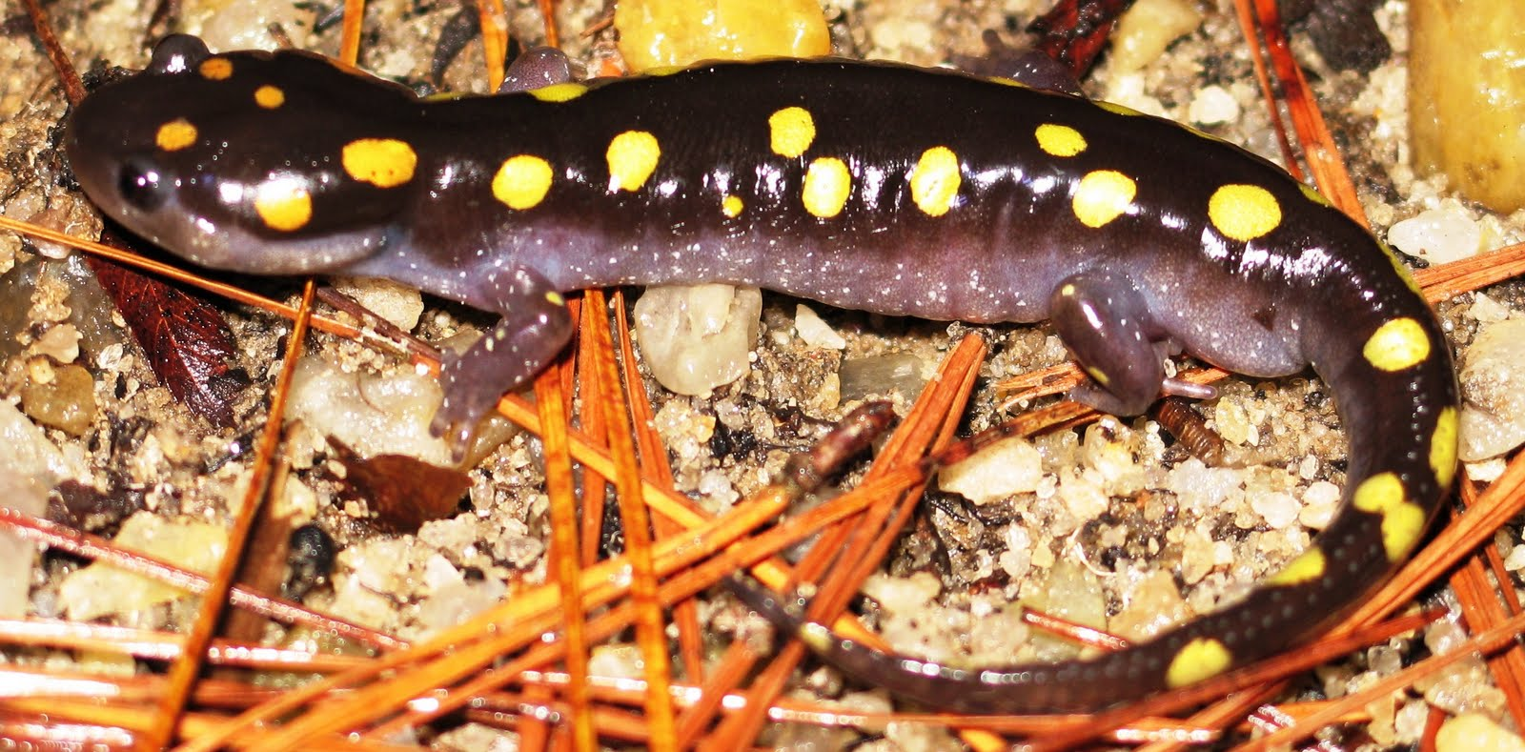
Salamanders and newts belong to this order. The Fire Salamander and several newt species are typical of our country. The Fire salamander is carnivorous – it feeds on worm, insects and their larvae. Fertilisation is internal. The fertilised eggs develop in the female body, where they hatch. Female enter the water and “give birth” to larvae, which are about 20 mm long. Animals which reproductive like the salamander are called ovoviviparous.
Fire salamander bright coloring warns its enemies that it is poisonous.

Slide 13
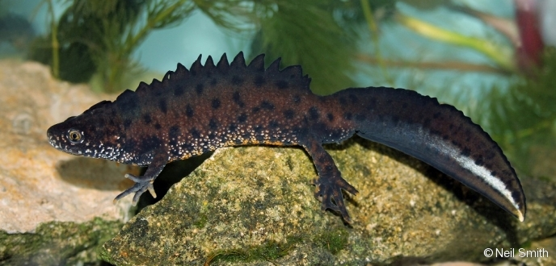
Great crested newt inhabits water basins with aquatic vegetation – marshes, ponds and lakes. Newts can regenerate limbs and toes if they are damaged or lost

Slide 14
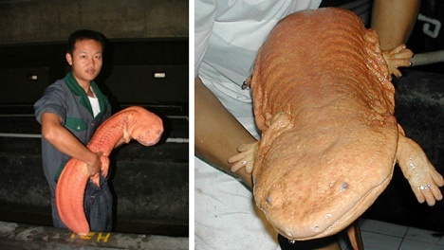
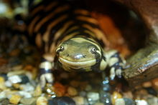
Chinese Giant Salamander
The Chinese giant salamander can grow to be nearly six feet long.
Tiger Salamander

Slide 15
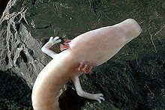
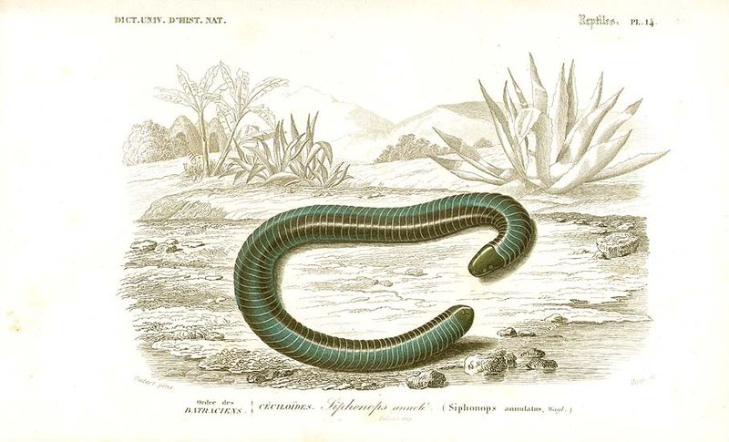
Proteus (Apoda, Legless amphibians)
Proteus have no limbs.
Their fertilisation is internal.
Live mainly in the tropical regions of South America, Africa. In Europe live one species.

Slide 16
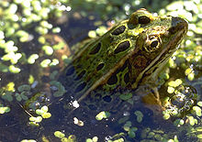
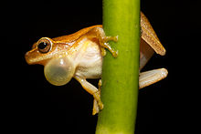
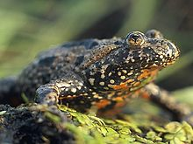
Anura (frogs)
Order Frogs (Anura, which main tailless) comprises about 80% of all amphibians. The body of adults is wide and short and they have not tail. Frogs have longer hind limbs. On land they move by jumping. Hind limbs have webbed toes that help in swimming. All frogs reproduce in water.
leopard frog
Call
European Fire-bellied
Toad

Slide 17
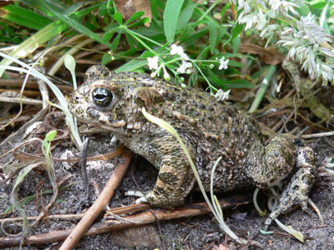
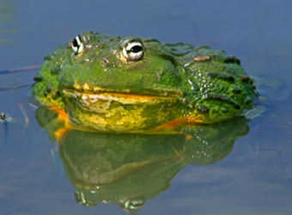
The European Green Toad have skin glands that produce a poisonous secretion, which protects it from enemies.
The Eastern Spade - foot Toad produce a secretion with the smell of garlic. This secretion is not harmful to humans, but it is dangerous for lizards, birds and small mammals.

Slide 18
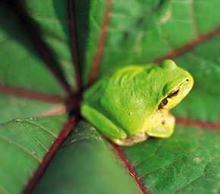
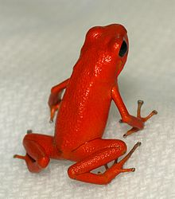
Amazing, protected and poisonous frogs
Most of the amphibian in our country are protected. Such are the salamander the Proteus, toads, the European Tree frog, the Greek Stream Frog. As a result of climatic changes air and water pollution and destruction of their habitats the number amphibian species is decreasing worldwide.
Oophaga pumilio

Slide 19
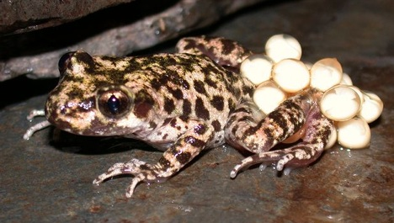
Mallorcan Midwife Toad
Mallorcan Midwife Toad
The Mallorca Midwife.
The father serves of this frog as a surrogate for the eggs until they hatch, it carries the eggs and even cares for them after.
Mallorca Midwife toad

Slide 20
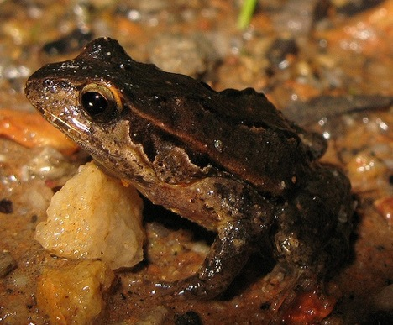
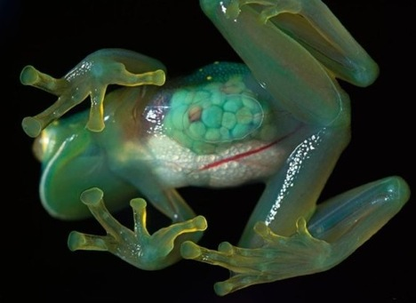
The quacking frog makes a sound that is just like a small baby. Like many frogs, the quacking frog is endangered.
The glass frog is an endangered species of tropical rainforests in Central and South America where the glass frog may go extinct.
quacking frog

Slide 21
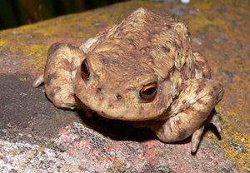
African Bullfrog
African Bullfrog is one of the most adaptable amphibians on earth. Protected in an underground chamber, the frogs wait the rainy season. When the rainy season begins, they occupy floodplains and puddles.
The African bullfrog is carnivorous, eating insects, small rodents, reptiles, small birds and other amphibians. Cannibalism is a common event of the bullfrogs. Many of their first meals are the eggs and the larvae.

Slide 22
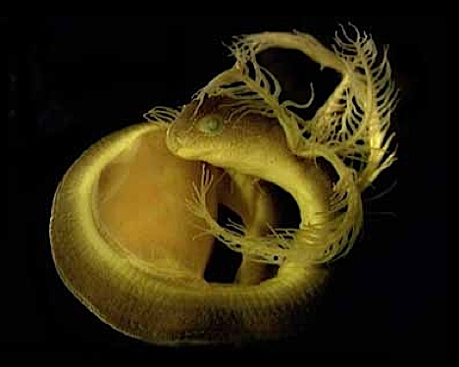
More Legless Amphibians: the Icthyophis Kohtaoensis
Ones of the strangest legless amphibians, which have the tentacles on their heads. Though they look like soft worms, they have rows of very sharp teeth. There are over 120 species around the world that have been discovered so far, but many of them are endangered.
legless amphibians

Slide 23
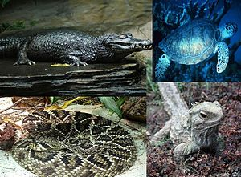
class Reptilia
Reptiles are animals in the class Reptilia. They are characterized by breathing air, laying shelled eggs (except for some vipers and constrictor snakes that give live birth), and having skin covered in scales and/or scutes. Reptiles are classically viewed as having a "cold-blooded" metabolism.
Caiman crocodilus),
Green Sea Turtle
Sphenodon punctatus
Eastern Diamondback

