Slide 1
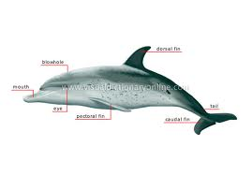
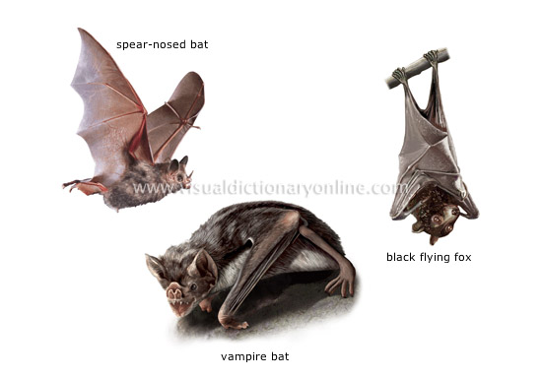
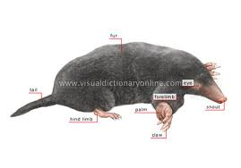
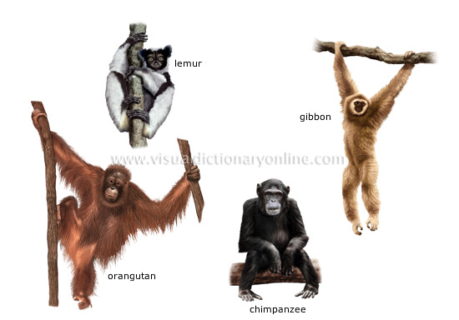
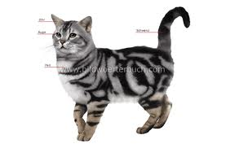
Class Mammalia (Mammals)
Mammals are adapted to various conditions in a terrestrial environment – they inhabit water,
air and soil.
mole

Slide 2
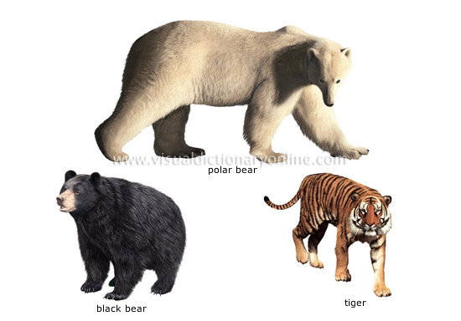
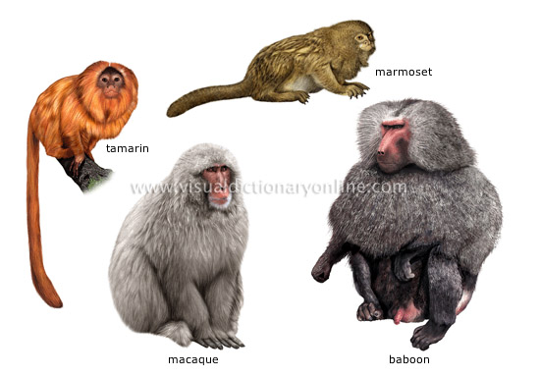
Their constant body temperature – 36-37 ° allows them to be independent of the ambient environment and they are spread from the equator to the poles.
The fur (hair), that is covering the body, allow them mainly for maintaining internal body temperature and is providing protection from insect bites. In temperate climatic zones, mammals change their fur in spring and autumn. Summer fur is sparse and short, while in winter it is thick and long.

Slide 3
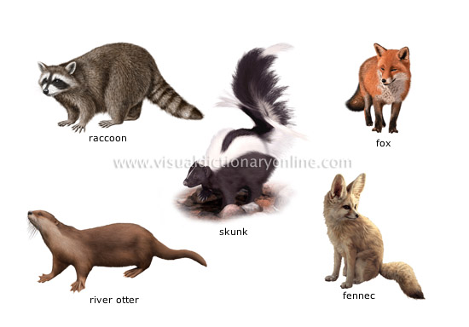
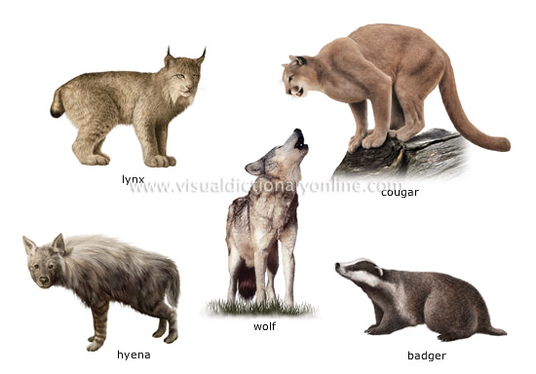
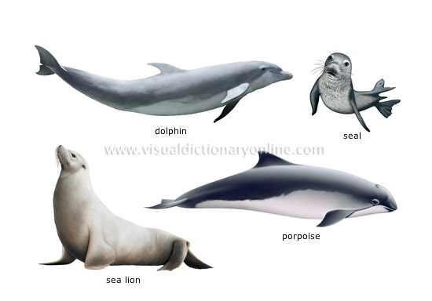
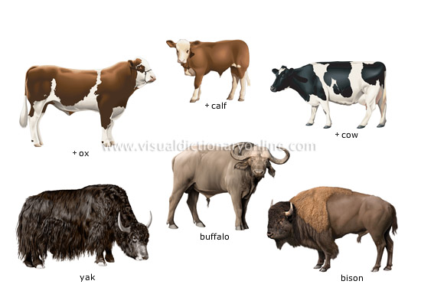
Distinguishing features
The body of mammals is covered with fur (hair).
The skin is rich in glands: sebaceous, sweat, smell and mammary. They have mammary glands that produce milk to feed
their babies.

Slide 4
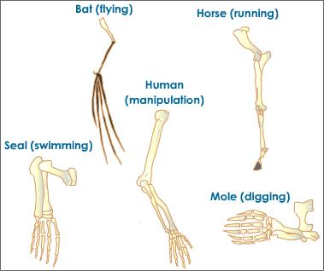
Different limbs are characteristic, related to the way of locomotion. In running, flying, swimming mammals the limbs have different sizes and shapes.
SEAL

Slide 5
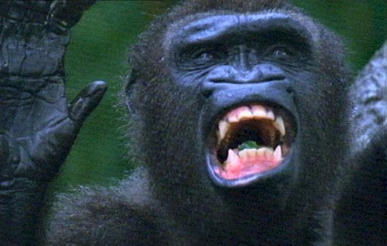
They have different teeth –
for cutting (incisors), tearing (canines) and grinding (molars). Mammals feed with various types of food.

Slide 6
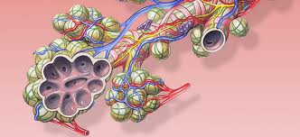
Internal structure
Pulmonary system
The lung consist of pulmonary sacs (alveoli) that increase the total surface area of gas exchange.

Slide 7
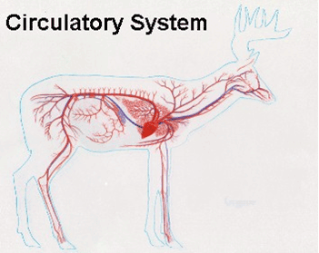
The heart consists of four chambers. Mammals are two types of circulation –pulmonary and systemic.
There is a muscular septum between the chest and abdominal cavity – diaphragm – which takes part in the breathing process.

Slide 8
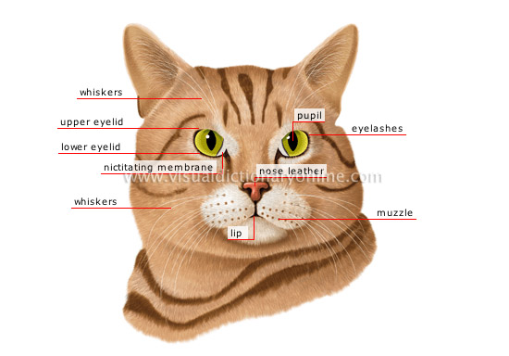
The telencephalon is the largest part of the brain and covers the other parts. The cerebral cortex is folded and well developed.
The sensory organs are also well developed. The eyes are protected by upper and lower eyelids.
Mammals are the
outer ear and ear
pinna.
ear
cats have a highly developed sense of hearing.

Slide 9
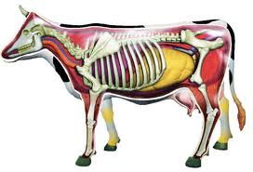
The reproductive system consists of ovaries (in females) and testes (in males). The mammals have mating rituals and they care of babies.
Fertilisation is internal.
Most mammals are viviparous. They feed their babies with milk rich in proteins, sugars, vitamins, minerals.

Slide 10
classifications
1subclass
Monotremes (egg layers) platypus and echidna
2 subclass
Marsupials Pouch
3 subclass
Placentals womb

Slide 11
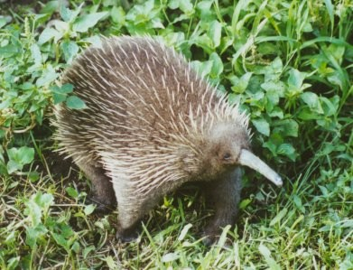
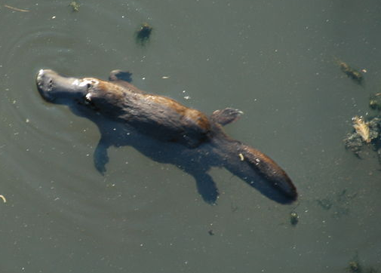
Monotremes
The most primitive mammals .
They reproduce with eggs. The eggs are big, rich in nutrients and covered which a hard shell. They hatch in nests or in special skin sacs on the female body.
They have a cloaca – a joint opening for the digestive, excretory and reproductive systems.
Adults have horny plates on their jaws.
Their body temperature is low
and varies greatly.

Slide 12

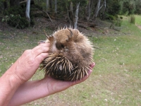
Monotremes are mammals that inhabit Australia and islands. There are five extant species, which are grouped into two families Platypuses and Echidnas.
The platypus lives in holes near sea coast, river or likes.
The echidna body is covered in sharp spines. It is short and strong claws. It uses them to dig in the ground in order to find food (termites, ants and worms) and to dig its nest.

Slide 13
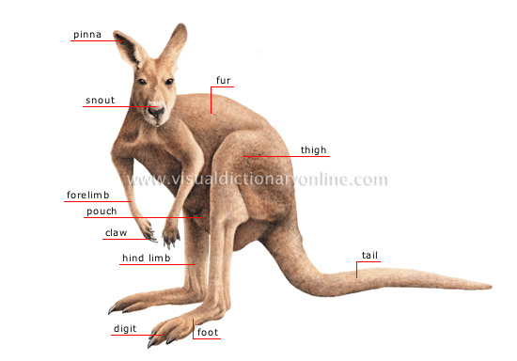
Marsupials
These animals are called marsupials because their females have a skin pouch (from Latin marsupium – a pouch) on the ventral part of their body.
Their body temperature is higher than of Monotremes

Slide 14
The pregnancy period is short and the newborn is underdeveloped – blind and helpless. The female usually has a ventral pouch in which the embryo develops after birth.
In the pouch, the newborn attached itself to the nipples.
The female injects the milk into newborn’s mouth by contracting the muscles on the mammary glands.

Slide 15

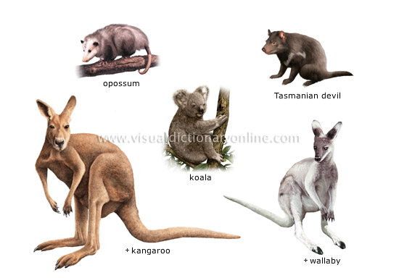
examples of marsupials
Today, marsupials live on the Australian continents, New Zealand , South America and North America. There is only one type of opossum.

Slide 16
Marsupials included about 250 extant species.
tasmanian devil
koala
Grey kangaroo

Slide 17
Placental mammals
Placental mammals are the most numerous group of extant mammals. They inhabit the whole planet except for Antarctica. They have different habitats and developed various life forms – on land, under the ground, in water, on trees and in the air.

Slide 18
Distinguishing feature of placental mammals
The pregnancy period is long and the newborn offspring are full developed.
In females, during the pregnancy, a special organ is formed – a placenta in uterus(womb), through which the embryo is nourished. This organ gives the name of groups.
The mammary glands have nipples, by which breast milk is delivered to newborn offspring.
Placental mammals are grouped into seventeen orders.

Slide 19
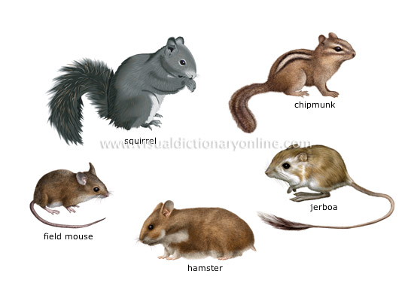
Order Rodents
Rodents are the most numerous group. Its representatives are small animals which have long and sharp incisors that grow throughout their whole life.
Among its representatives are squirrels, mice, hamsters, dormice, rats, et.

Slide 20
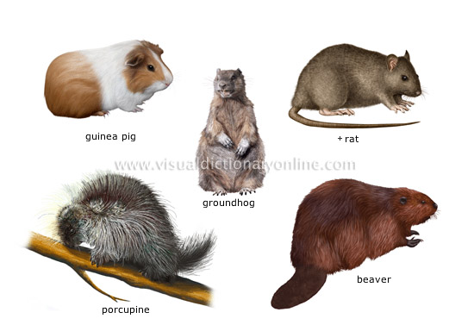
examples of rodents
examples of rodents [1]
beaver

Slide 21
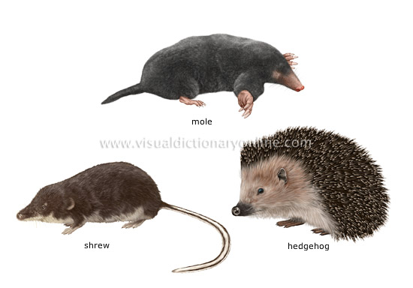

INSECTIVOROUS MAMMALS
Vertebrates (about 370 species) with four limbs and a body almost entirely covered with hairs and sometimes barbs; they feed on insects. Moles , hedgehog , shrews belong to order Insectivorous.
Hedgehog

Slide 22
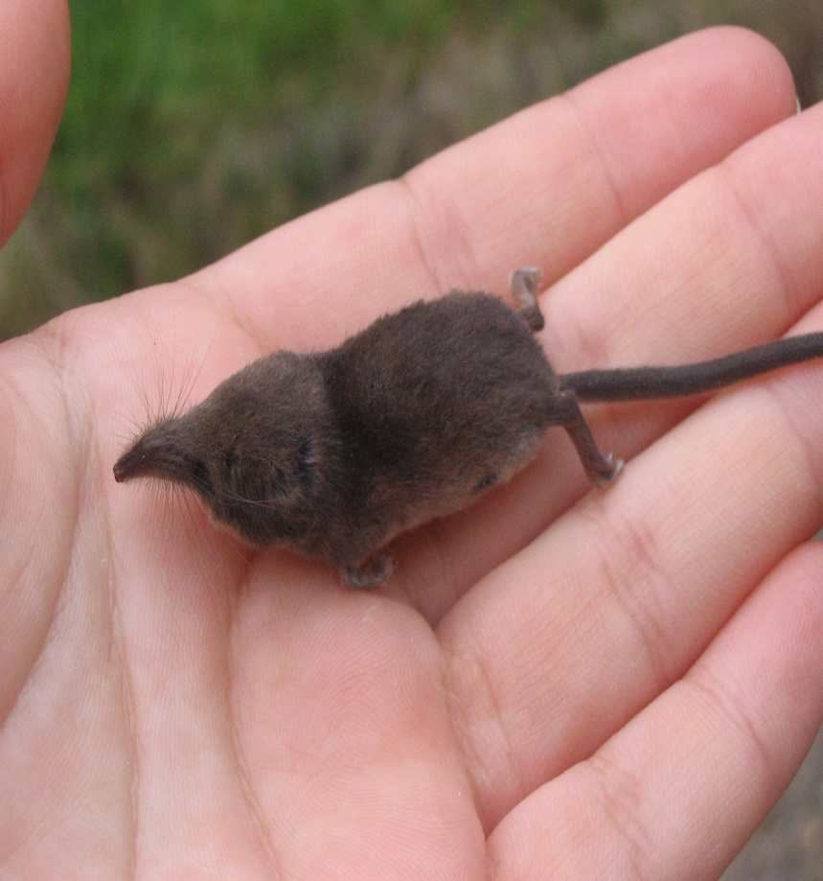
Orders insectivores
Insectivores comprise the most primitive placental mammals.
The Etruscan shrew is the smallest mammal species.

Slide 23
FLYING MAMMAL
Very widespread groups, some 900 species of bats live mainly in colonies, in trees or in caves.
The Bats have wings with thin a membrane of skin , connecting the fingers of the front and hind limbs, the body and the tail.
There are 35 bat species in Bulgaria. All of them are protected both in Bulgaria and the rest of Europe.

Slide 24
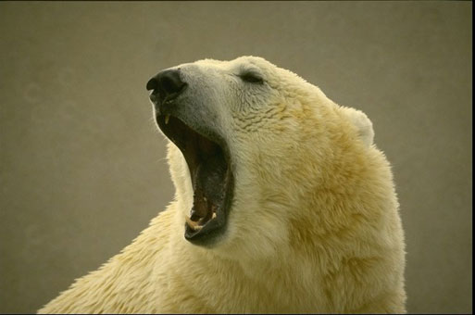
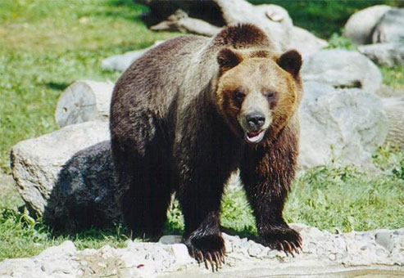
CARNIVOROUS MAMMALS
Carnivorous mammals (about 270 species) that have strong canines and sharp molars adapted for eating flesh.
Polar bear
Black bear
tiger

Slide 25
examples of carnivorous mammals
Brock
hyena

Slide 26
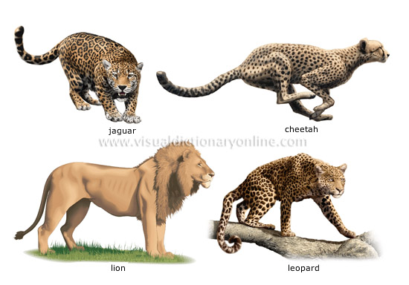
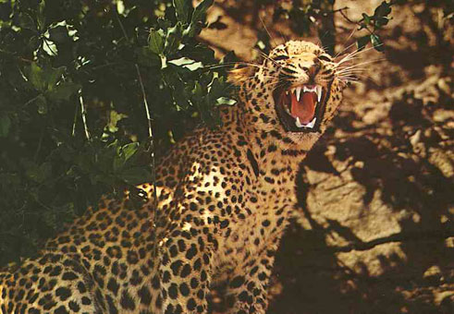
Carnivorous
leopard

Slide 27
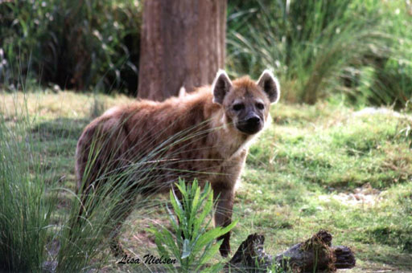
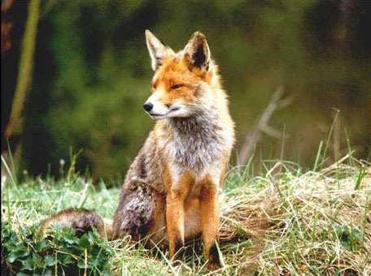
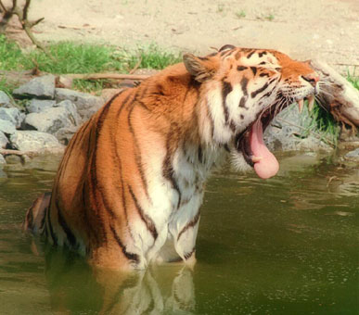
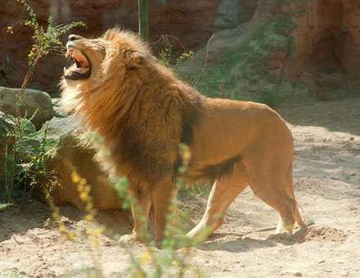
hyena
fox
lion
tiger

Slide 28
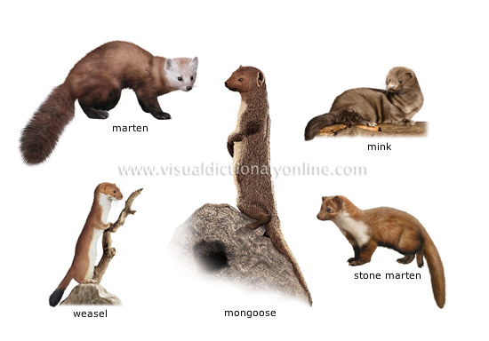
examples of carnivorous mammals
weasel

Slide 29
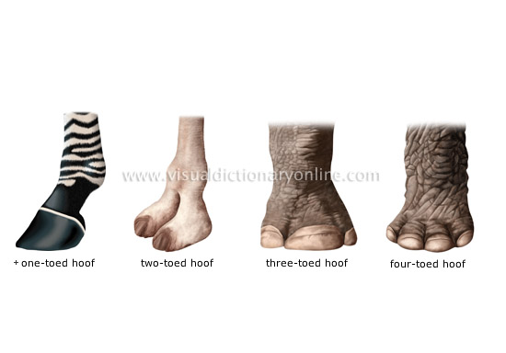
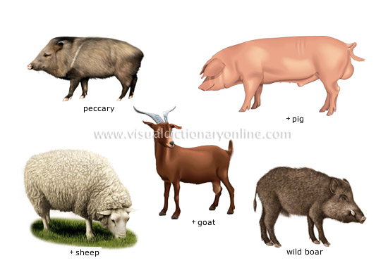
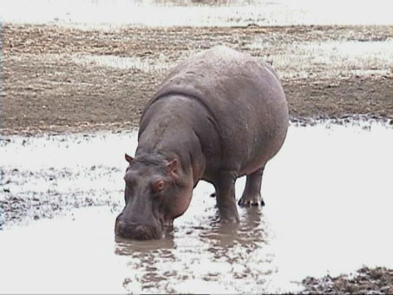
UNGULATE MAMMALS are even-toed and odd-toed ungulates
pigs
Even-toed ungulates. They comprises herbivorous large mammals, which have only two toes on each limb. These toes are covered with horny structures – hoofs. Their way of moving are running. Pigs, hippopotamuses, deer, antelopes, goats, giraffes, etc. belong within this order.
hippopotamus

Slide 30
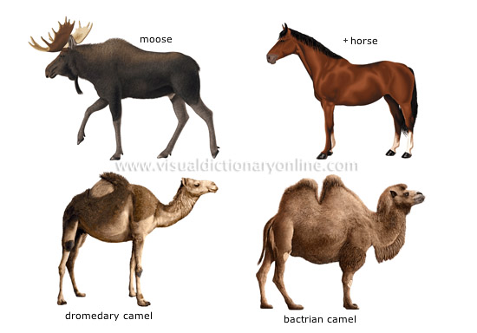
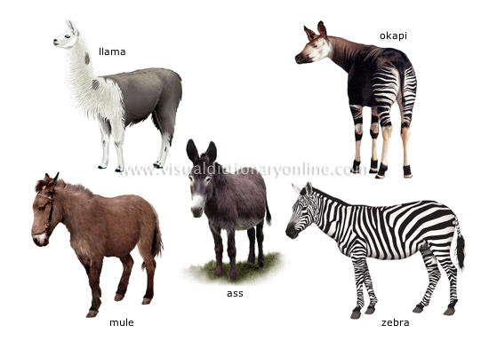
.
Even - toed ungulates
bison

Slide 31
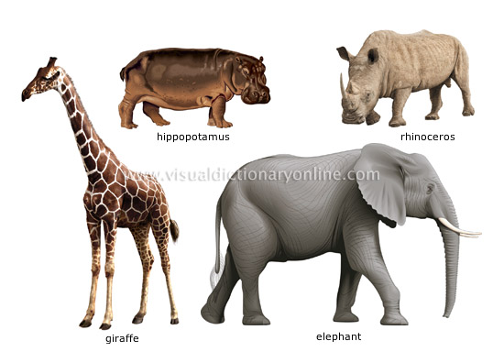
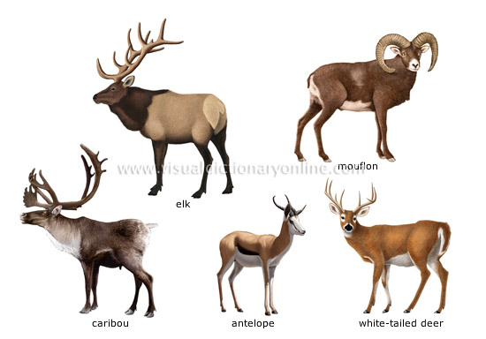
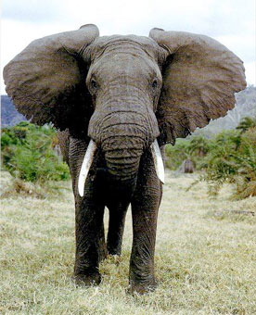
Giraffe
examples of ungulate mammals
There are many species of ungulate mammals; some are wild, some are domesticated.
elk
mouflon
. elephant
antelopes

Slide 32
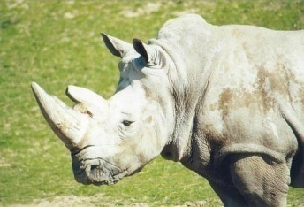
Odd-toed Ungulates
Odd-toed Ungulates comprises herbivorous mammals whose limbs adapted for running
Tapirs, rhinoceros, horses etc. belong within this order.
In them, only the middle toe is developed. It is covered with a horny substance to form a hoof.

Slide 33
Odd-toed Ungulates

Slide 34
PRIMATE MAMMALS
Vertebrates (about 200 species) with hands and feet, with five digits ending in a nail; they live mainly in trees and can stand erect.
tamarin
examples of primates
Many species are protected, especially because destruction of their habitat

Slide 35
Order Primates includes prosimians, simians(apes) and hominids. The pregnancy lasts 7 to 9 months. The Hominids apes are orangutans, chimpanzees and gorillas.

Slide 36
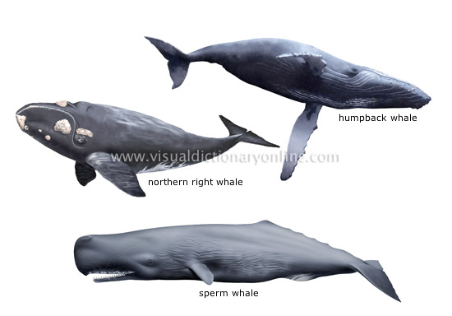
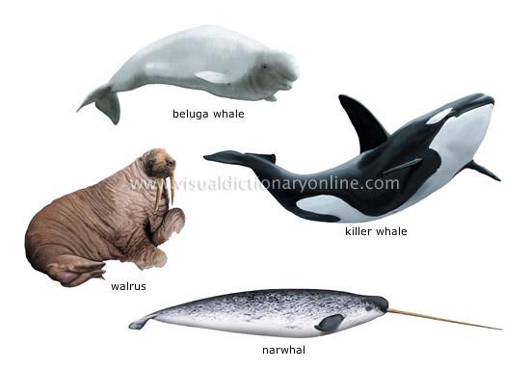
MARINE MAMMALS
Carnivorous aquatic vertebrates (about 116 species) with limbs evolved into fins, skin that is smooth or covered in short hairs, and sometimes a dorsal fin.
humpback whale
northern right whale
beluga whale
sperm whale
killer whale

Slide 37
Order cetaceans includes the only mammals adapted to life in water – dolphins, porpoises and whales. They look more like fish. The fore limbs evolved into flippers, while the hind ones are rudimentary.
dolphin
Porpoise

Slide 38
Marine mammals: many actively hunted species (more than 110 out of 116) are protected or are subject to hunting restrictions.
Marine mammals are orders: fin-footed mammals and cetaceans. Seals and walruses are among fin-footed. Their body is elongated, they have short webbed legs, adapted for swimming.
walrus

Slide 39
Many placental mammals are endangered animals. The Bulgarian Red Data Book includes 19 species – marten, marbled polecat, brown bear, otter, wild cat, monk seal, all bats, etc.

